Slide 1
What is a computer file?
Mack 2021

Slide 2

What is a computer file?
When we want a computer to remember data for later, we store it in a file.
To make it easier to sort through our files, we give each file a memorable name.
The computer keeps track of additional details, like when the file was last updated, the type of file, and who's allowed to edit it. That's called metadata: the data about the data.

Slide 3
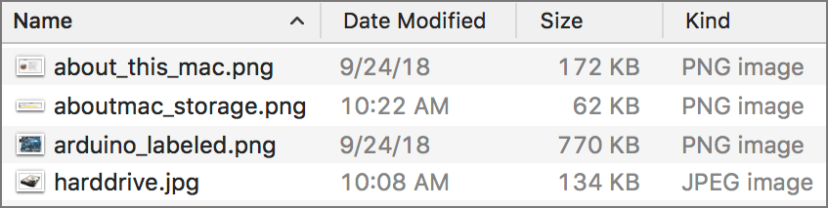
Here's a file listing from my Mac:

Slide 4
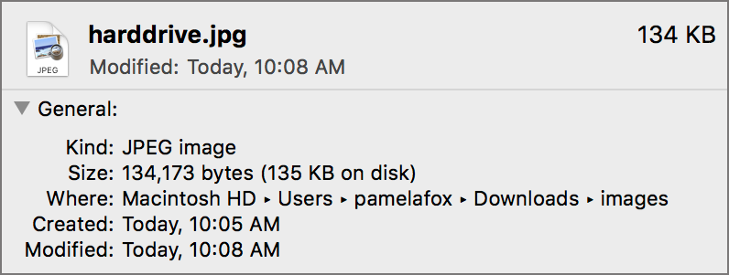
Clicking on an individual file pops up a dialog with even more metadata:
Notes:
In this lesson, we'll dive deeper into two very important bits of metadata: the file kind and the file size.

Slide 5
File types

Slide 6
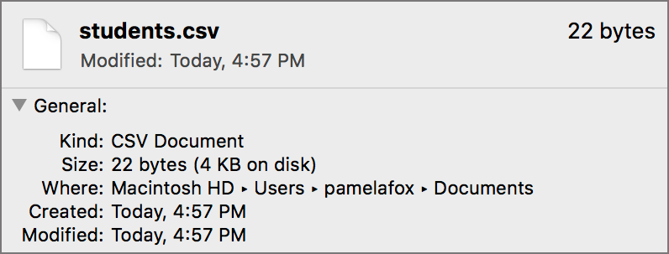
File types
Computers store all files as binary data, long strings of 111s and 000s. Files represent all different types of data, however—like images, videos, documents, text files, and spreadsheets. Even applications are files.
How does a computer know that one chunk of data is an image, and another chunk is a spreadsheet?
Each file has a type/kind/format, which is often reflected in its file extension. For example, "students.csv" is a "CSV Document" and has the extension "csv".
🔍 Browse around your desktop now and see what kind of files you have. If you can't see the file extensions, your computer may be setup to hide extensions by default. You can often turn extensions back on in settings. Just do a search online for "Show extensions on [your computer type]".

Slide 7
Detecting file types
Files don't always have an extension, and sometimes an extension doesn't reflect the actual file format. In that case, computers can try a number of techniques to figure out the file type, so that it can open that file in the most appropriate program.
One way to detect the file format is to look for clues inside the file data itself. Many file types start with a "file header" with metadata.
For example, a GIF file always starts with the letters "GIF", encoded in binary according to the ASCII standard:
0100 0111 0100 1001 0100 0110
If a computer sees that sequence of binary data, it has a high confidence that the file is a GIF and can send it to an image viewing application. The application can either successfully read and display the pixels, or let the user know that the file isn't a valid image file.

Slide 8
Exploring file types
Our computers load many different types of files every day. You might already be familiar with many of those file types, but you might also discover exotic new file types in your journey into computer science.
🔍 Discover more file types in the upcoming exercises. Never heard of a file? Just search for more information online with a query like "svg file format".

Slide 9
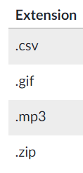




OPEN FILE FORMATS
The following table lists the extensions of four "open formats", file formats that can be used by anyone.
Match each extension to an example of data that it can store:

Slide 10
File sizes

Slide 11
File sizes
Computers can store much more data than they could 20 years ago, but storage is still limited. That's why file size matters: perhaps our computer's hard drive can store 10,000 GIFs of cats, but it can only store 10 full-length movies about cats.
File sizes are always measured in bytes. A byte is a sequence of 8 bits (and remember, a bit is the smallest piece of digital information, 000 or 111).
A single byte is enough bits to represent 256 numbers, because 2^8 = 2562
8
=2562, start superscript, 8, end superscript, equals, 256. That also means a byte is big enough to represent a single letter in the ASCII encoding standard.

Slide 12
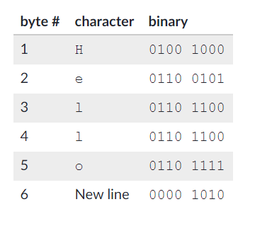
A small file
If a byte is enough to represent a single letter, then a 5-letter long text file should be 5 bytes, right?
🔍 Try it yourself: Make a file with just the word "Hello" and then view the file metadata to see the total file size.
When I tried it, my computer made a file with a size of 6 bytes. I expected 5 bytes, since I typed 5 letters and the computer only needs 1 byte per letter. As it turns out, my editor added a new line automatically and that also required a single byte of representation.

Slide 13
Larger files
Files are often much larger than a few bytes. A 400x400 photo of my face is a whopping 22,096 bytes. A 33-second movie of my cat is 4,614,170 bytes.
To make it easier to talk about larger file sizes, we use larger units, starting with the kilobyte. If you're familiar with units like kilometers and kilograms, a kilobyte sounds like 1000 bytes, but it's not—or at least, it's not always.
When the term was first invented, a kilobyte referred to 1024 bytes. Computer scientists wanted to use familiar terms, but computers are based on the binary system, so it made more sense to group bytes into powers of 2 and 1024 is 2^10.
Some computers started using a kilobyte to refer to 1000 bytes—especially hard drive manufacturers, since it made their drives sound bigger. Now we live in a confusing world where 1 kilobyte sometimes equals 1024 bytes and sometimes equals 1000 bytes.

Slide 14
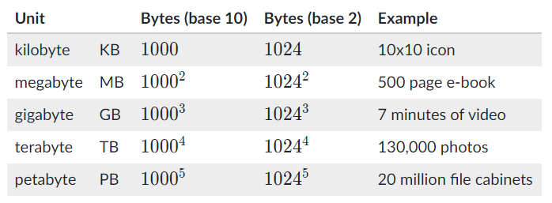
Larger files
Any given computer will be consistent in its units, so you can compare relative file sizes, even if you're not sure the exact conversion from kilobytes to bytes. In the scheme of things, 1000 is close to 1024, so you'll get a good idea for the size of the file either way.
Once a file size is bigger than 1024 kilobytes (or 10001, depending which computer you ask), we can start using the bigger units like megabytes, gigabytes, terabytes, and petabytes.
The table above gives examples of how much data you can store for each unit. That column is actually a bit deceiving, because file sizes depend on whether the data is "compressed", and how much they've been compressed. 1 gigabyte could store 1 minute of uncompressed video, or it could store 1 hour of compressed low-resolution video. We'll learn much more about compression soon.
🔍 Search online for more examples of data sizes. What else could you fit in a gigabyte, terabyte, or petabyte? Share any interesting discoveries in the Tips & Thanks below.
Notes:
🍐 This is a Pear Deck Text Slide
🍐 To edit the type of question, go back to the "Ask Students a Question" in the Pear Deck sidebar.

Slide 15
Files and sizes

Slide 16
Marquis needs to upload a photo of himself to a website, and the website requires that photos be in JPEG format. However, his only photo is in the GIF format.
Which of these approaches should he take?
Notes:
🍐 This is a Pear Deck Multiple Choice Slide. Your current options are: A: He can remove the extension from the filename entirely, renaming it from "marquis.gif" to just "marquis", and upload the renamed file., B: He can open the file in an image editing application, export it as a JPEG, and upload the exported JPEG file., C: He can add another extension to the filename, renaming it from "marquis.gif" to "marquis.gif.jpeg" and upload the renamed file., D: He can rename the file from "marquis.gif" to "marquis.jpg" and upload the renamed file.,
🍐 To edit the type of question or choices, go back to the "Ask Students a Question" in the Pear Deck sidebar.

Slide 17
Kevin is entering the JS1K contest, a contest to write an interesting program in just 1KB of JavaScript code. He's hoping he can rewrite a program that's currently 1MB and enter that for the contest.
If he succeeds, how much smaller will his new program be?
Notes:
🍐 This is a Pear Deck Multiple Choice Slide. Your current options are: A: Around 1/2 of the original size., B: Around 1/10 of the original size., C: Around 1/100 of the original size., D: Around 1/500 of the original size., E: Around 1/1000 of the original size.,
🍐 To edit the type of question or choices, go back to the "Ask Students a Question" in the Pear Deck sidebar.

Slide 18
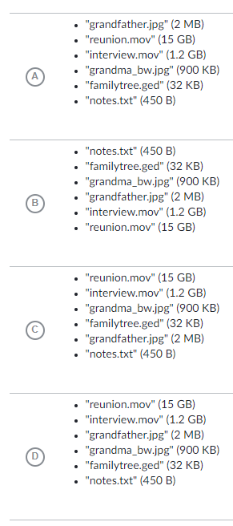
Jermaine is storing files on his laptop for a project about his family ancestry.
Which of these lists correctly sorts the files from largest size to smallest size?
Notes:
🍐 This is a Pear Deck Multiple Choice Slide. Your current options are: A: A, B: B, C: C, D: D,
🍐 To edit the type of question or choices, go back to the "Ask Students a Question" in the Pear Deck sidebar.

Slide 19

Connect to your own life:
What’s something interesting you learned today?
Can you relate this to something in your own life?
Notes:
Real-Life Relevance
Use this template to help students connect the lesson to their own life. Does something from class relate to something they learned in another class? Was something interesting or surprising? Will it be useful to them? Did they learn anything that someone else they know would be interested to hear about? Helping students make those connections will help them retain the information, because it becomes more relevant to their lives.
🍐 This is a Pear Deck Drawing Slide
🍐 To edit the type of question, go back to the "Ask Students a Question" in the Pear Deck sidebar.

